Slide 1






TRB Planning Applications Conference
Development of a Common Open Platform for AB Modeling: ActivitySim
RALEIGH, NORTH CAROLINA – MAY 17, 2017

Slide 2
OVERVIEW
NEED FOR COLLABORATION
PAST SOFTWARE EFFORTS
ACTIVITYSIM

Slide 3
NEED FOR COLLABORATION
PAST SOFTWARE EFFORTS
ACTIVITYSIM

Slide 4
NEED FOR COLLABORATION
AB models are extremely complex
Build and evaluate hundreds of millions of multifaceted choices for each person
Often have long run times, even when threaded and/or distributed
Need to evaluate many alternatives

Slide 5
NEED FOR COLLABORATION
They need to be usable, transparent, stable, extensible, optimized
This requires consistent thoughtful ownership and effective cooperation
Yet our industry has not had the forethought, institutions, or arguably the technology to do this

Slide 6
NEED FOR COLLABORATION
PAST SOFTWARE EFFORTS
ACTIVITYSIM

Slide 7
PAST SOFTWARE EFFORTS
Done in isolation
  For one agency who owns the work
  As part of a contract with no concern for others
  Often copying and pasting work done before
  Usually programmed by novices, not professionals
  Often an afterthought within the larger modeling effort

Slide 8
PAST SOFTWARE EFFORTS
Sometimes labeled open source, but not online, not tested, not built with others in-mind
Are more prototype than platform. Not much usability, transparency, stability, extensibility, and optimization
This parochialism leads to an industry full of prototypes, but nothing really amazing

Slide 9
NEED FOR COLLABORATION
PAST SOFTWARE EFFORTS
ACTIVITYSIM

Slide 10
ACTIVITYSIM
First, create shared ownership through a cooperative organization
By pooling funds through an umbrella agency – AMPO
To create a new ownership model

Slide 11
ACTIVITYSIM
Second, build and maintain the software in a completely open manner: online, open source, documented, tested, managed, …
Utilize best-in-class scientific computing Python/CC++ libraries such as pandas and numpy
Begin by replacing the modeling software in use at each agency

Slide 12
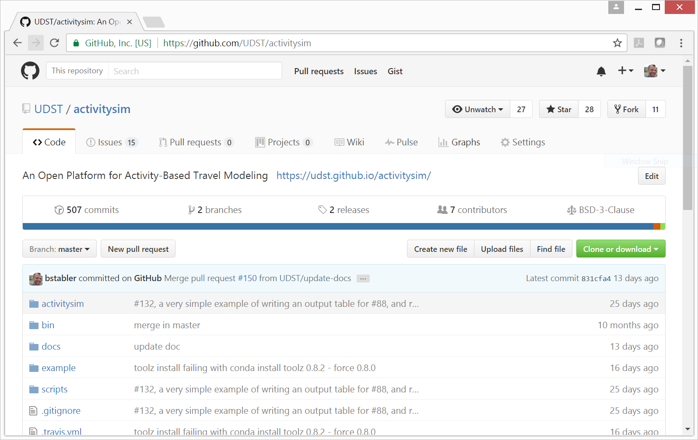
ACTIVITYSIM
Code - https://github.com/UDST/activitysim

Slide 13
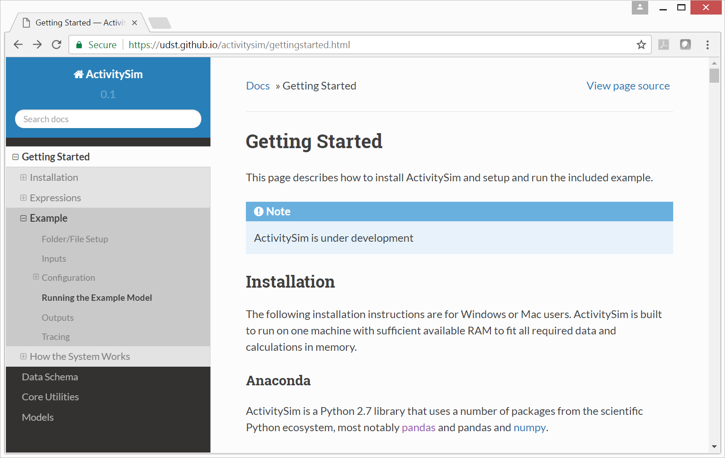
ACTIVITYSIM
Documentation - https://udst.github.io/activitysim

Slide 14
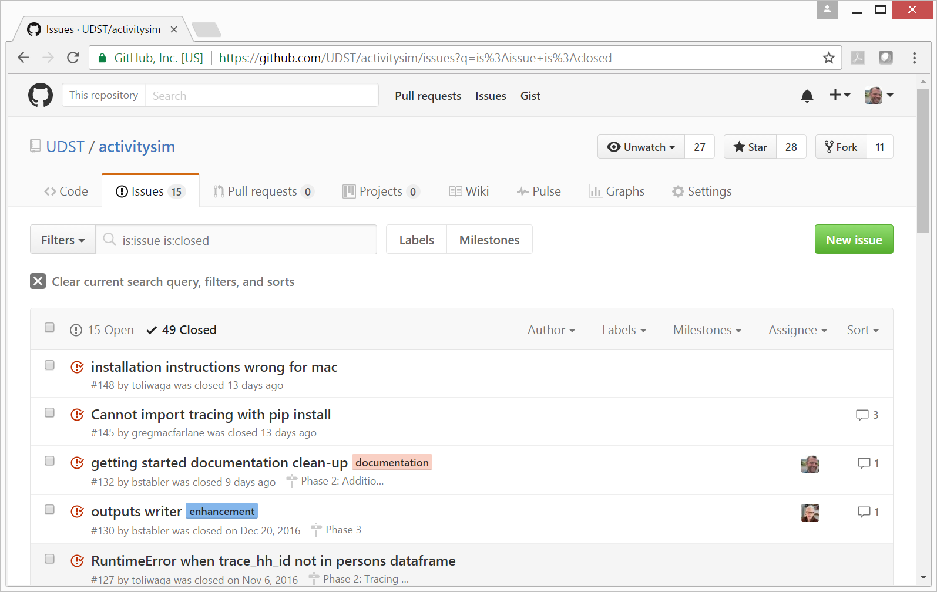
ACTIVITYSIM
Maintenance - https://github.com/UDST/activitysim/issues

Slide 15
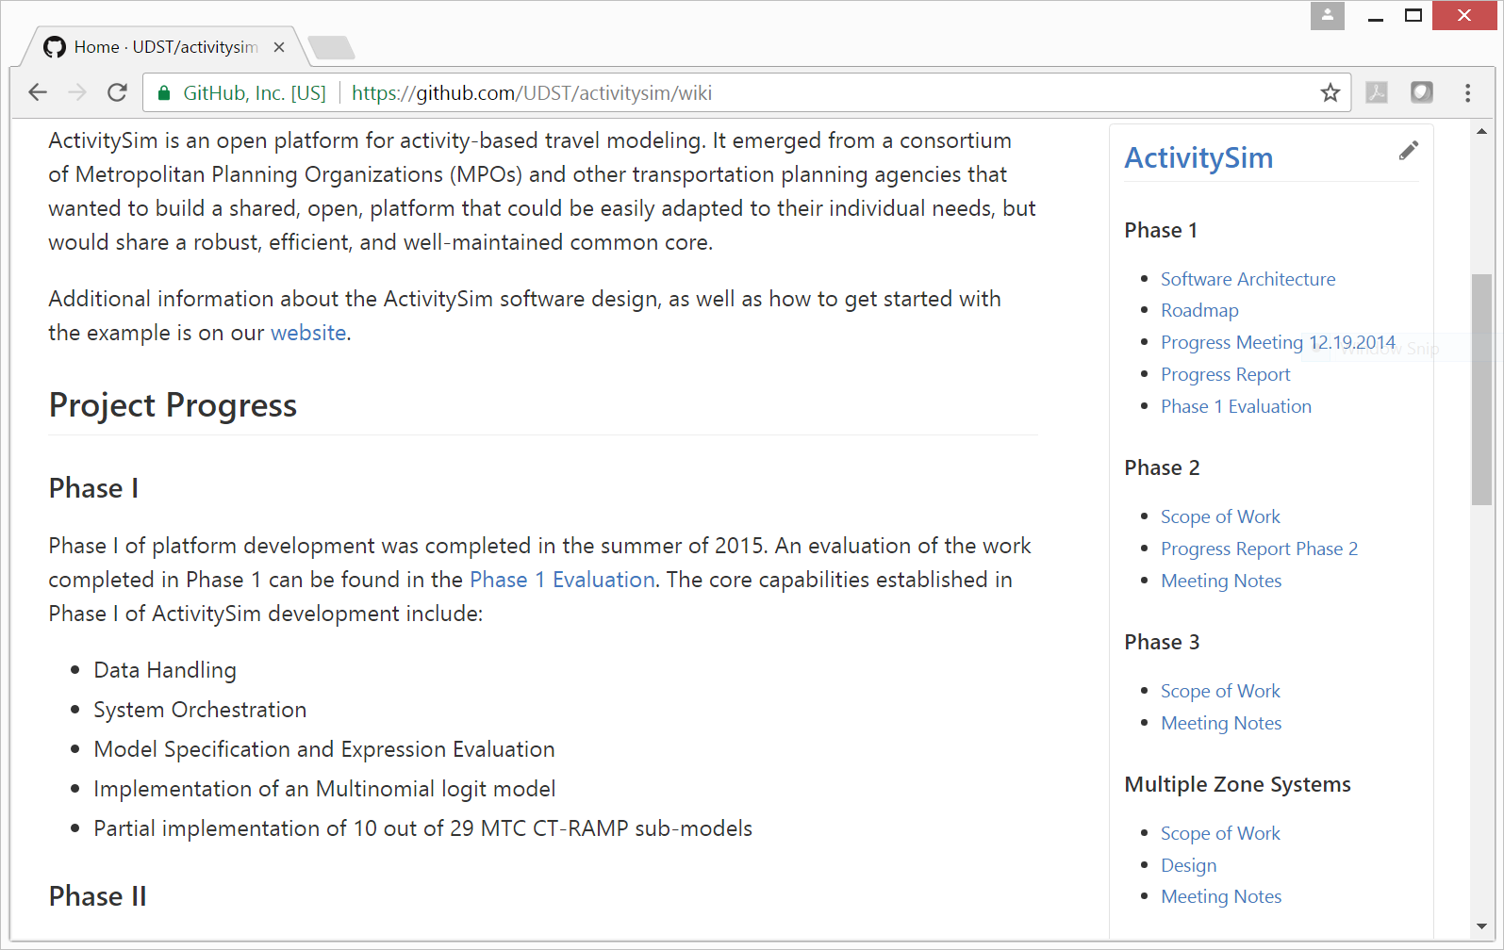
ACTIVITYSIM
Management - https://github.com/UDST/activitysim/wiki

Slide 16
ACTIVITYSIM
In our third year of development
Planning our first release in 2018
Planning for agency staff to start contributing to the code next year
Planning to replace existing AB software after that

Slide 17
ACTIVITYSIM
Is an open platform so contributions by others are welcome
Additional modules being developed
population synthesis
benefit cost analysis
How can we better cooperate to build more sustainable AB modeling software?

Slide 18
Contacts
Ben Stabler
Director
ben.stabler@rsginc.com
www.rsginc.com
Jeff Doyle
Director
jeff.doyle@rsginc.com
https://github.com/UDST/activitysim

